Slide 1
Welcome to ESOL Parent Open House! Catherine Law- Lead ESOL Teacher Amy Blakeney- ESOL Teacher Maria Belloso-Pint0- Parent Facillitator & Translator Acworth Elementary
2021-2022

Slide 2
A Quick Hello
We are the ESOL teachers here at Acworth Elementary and we are so excited to be working with you this school year! The ESOL department works closely with all grade level homeroom teachers to ensure our students and their families have the support they need. Please let us know if you need anything and any way, we can help you!

Slide 3
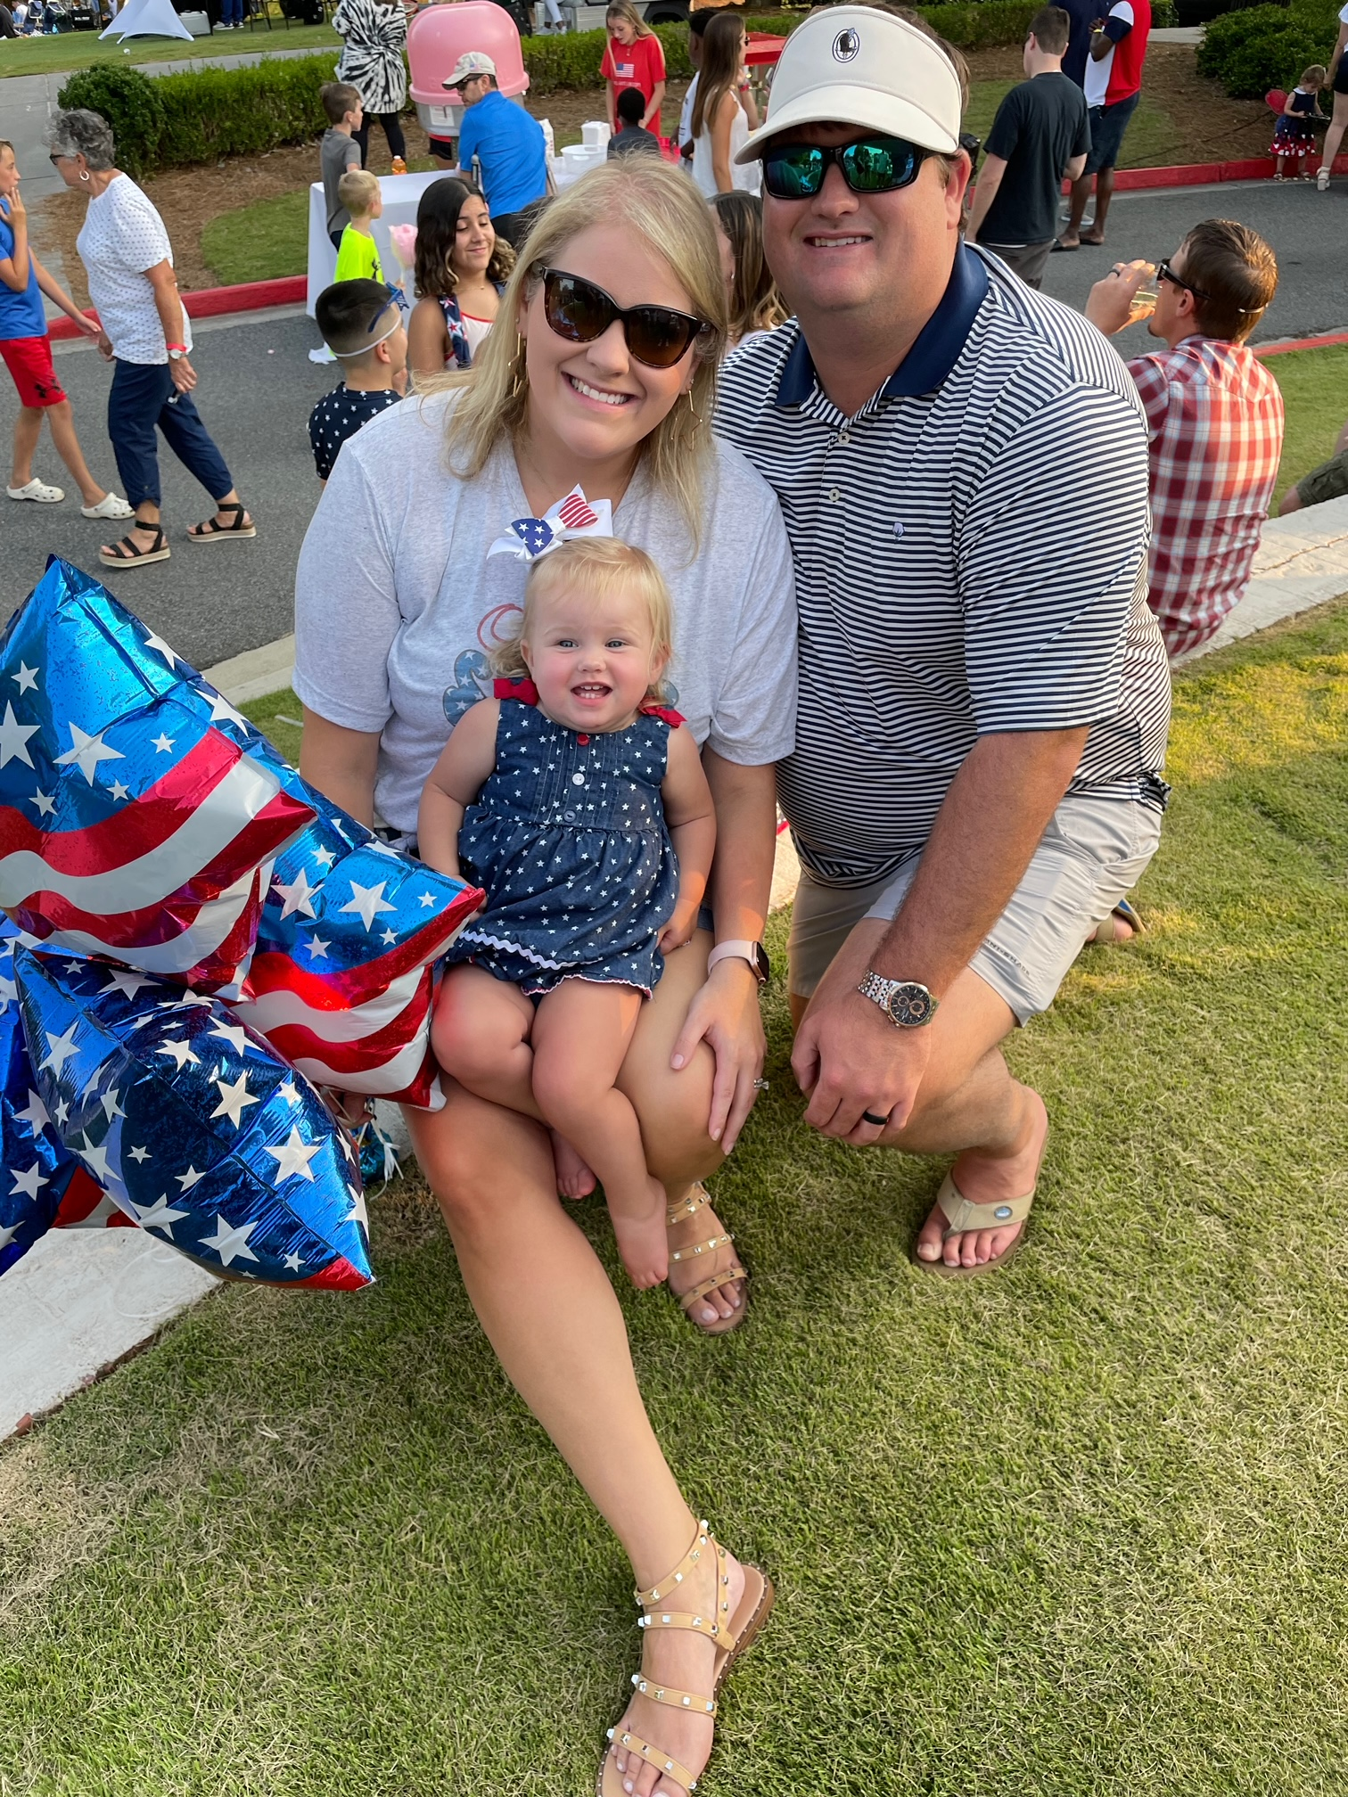
I have been a teacher for 11years and at Acworth Elementary for the past 5 years. I graduated from Kennesaw State University and got my Masters in Education at Walden university.
I am married with a baby girl and two wonderful and crazy dogs. When I am not teaching I like to craft, read, and hike. My favorite color is gray and teal. My favorite food is enchiladas and Chick-fil-A.
I am looking forward to getting to know each of you this school year.
Mrs. Law

Slide 4
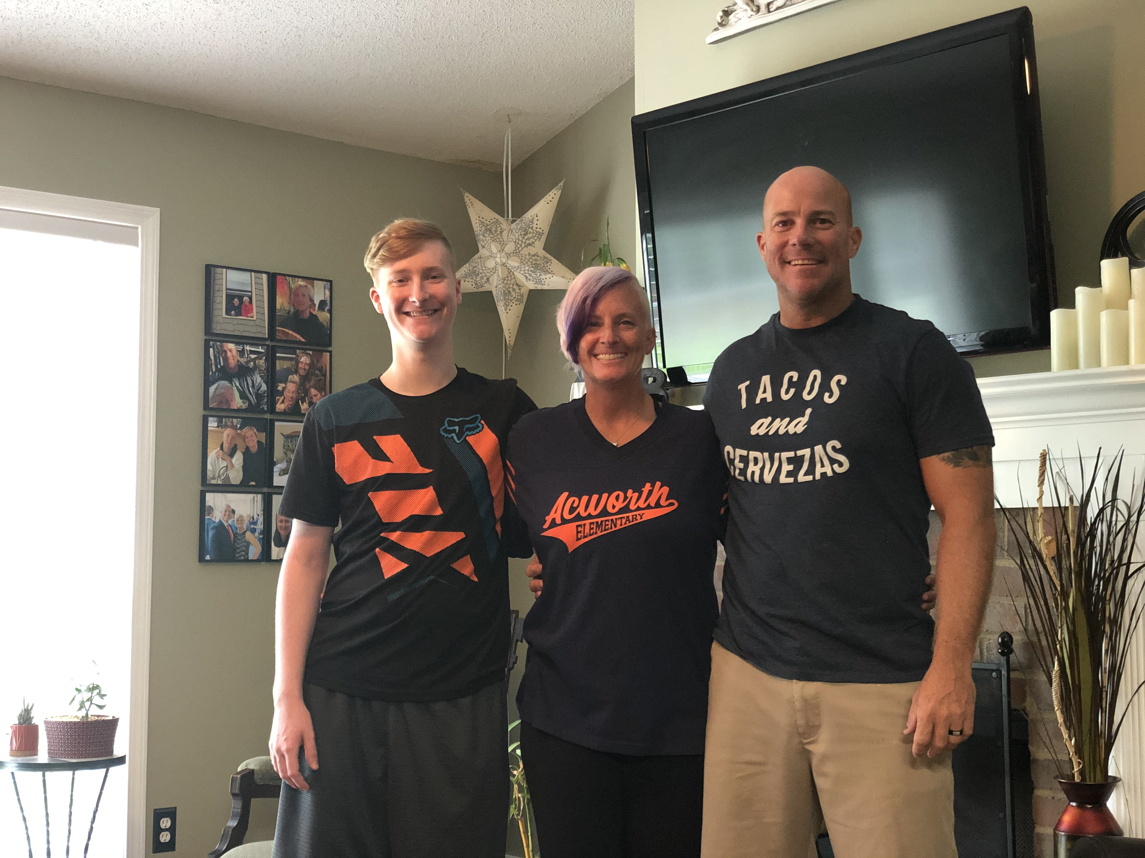
Mrs. Blakeney
Hello! I have been a teacher for 24 years and this will be my 14th year at Acworth Elementary. I have been married for 23 years and we have a son named Carter who is joining the Air Force! My husband is a firefighter for Cobb County and he likes to stop by the school to visit. I am so excited to be working with your students this year and look forward to a great year!

Slide 5
Goals for Open House
To help you understand the ESOL Program and our roles in helping your child succeed.
To explain my expectations for your child
To share information about how you can support your child’s learning this year

Slide 6
What is the ESOL Program
ESOL: A support program to help students of other languages be successful in the classroom. English
Speakers of
Other
Languages

Slide 7
Available Resources
Dreambox-All Grade Levels- math and reading support program.
Espark- All Grade Levels-math and reading support
Cobb Digital Library
Imagine Learning-Only for ELL students-Letter was sent home if your child qualified for the program.
ESOLAcworth.weebly.com : The ESOL department resources. Will be update throughout the school year.
Our school is offering many resources online through Clever.
The ESOL department also has a Weebly that you can access for additional support

Slide 8
School Policies
School Hours
Students are not to arrive before 7:15 am.
Students must arrive by 7:50 am.
Students cannot be checked out after 1:50 pm.
Dismissal begins at 2:20 pm.
School Policy Information
Emergency Information – Please make sure you have current information on ParentVUE.
Transportation – All changes must be made in writing.

Slide 9
Ways To Support Your Child’s Learning
Homework: 20/30 minutes of reading daily; math practice from teachers (2nd grade basic math facts, 3-5th grade memorize multiplication facts)
Computer programs: Prodigy, Dream Box, Imagine Learning, Espark
Learnzillion-math videos to help both student and parent understand new concepts. Creating by standard and grade level.
Support your child by supporting your child’s teachers
Talk with your child: have conversations about school, interests, how to plan for an activity, explain how to play a game, tell family stories.
Create a new word journal
Join ParentVue
Show that school is important by creating a study routine and a place to read or do homework.

Slide 10
ParentVUE and Report Cards
* Report cards and grades
* Communication tool
* If you need more support with ParentVue please reach out to your homeroom teacher or the front office
.
***Any corrections that need to be made for contact information must be made by the enrolling adult in ParentVUE.

Slide 11
Conferences
Conferences will be held in October and will be for a two-week time span.
More information will be sent as the time gets closer.
If you know you will need a translator for your conference, please contact your homeroom teacher ASAP.

Slide 12
PTA Information
Upcoming Events
The PTA contacts are:
President: Erin Myers
Vice President: Becky Banks
Treasurer: Cathy Jones
Secretary: Kimberly Wood
Please join! Membership is $7 and you will receive a car magnet.
You may contact the school office for further information.
September 9th – Chick-Fil-A Night
October 22nd – Character Parade
November 4th – LEGO build
November 19th – Fun Run
January 20th – Science/Art Fair/STEAM Night
February 17th – Chick-Fil-A Night
April 21st – Chick-Fil-A Night
**Some activities may need to be modified
due to Covid restrictions.

Slide 14
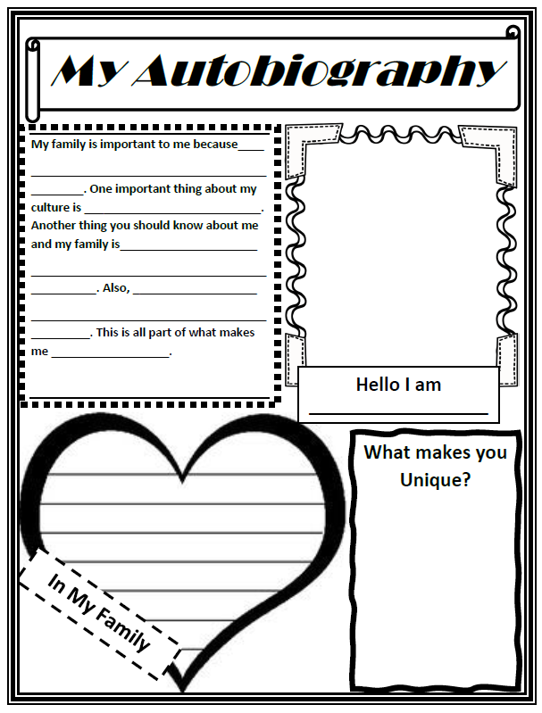
We Want to Know All About You!
Please fill out this Autobiography page and turn into either of us…You may also share any additional information you want us to know about your student, family, or culture.
* Located under the resources tab within the ESOL classroom

Slide 15
WWW.ESOLacworth.weebly.com
Catherine Law: Catherine.law@cobbk12.org
Twitter: @MLaw2018
Amy Blakeney: amy.Blakeney@cobbk12.org
Twitter: @AmyblakeneyAES

Slide 16
Questions???

