Slide 1
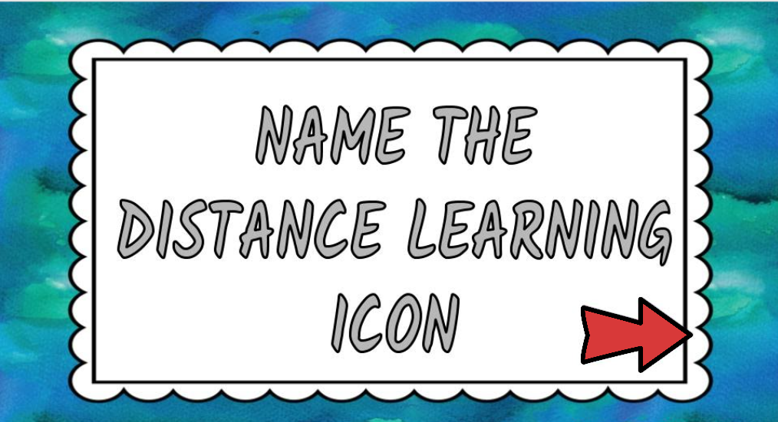

Slide 2
ZOOM

Slide 3
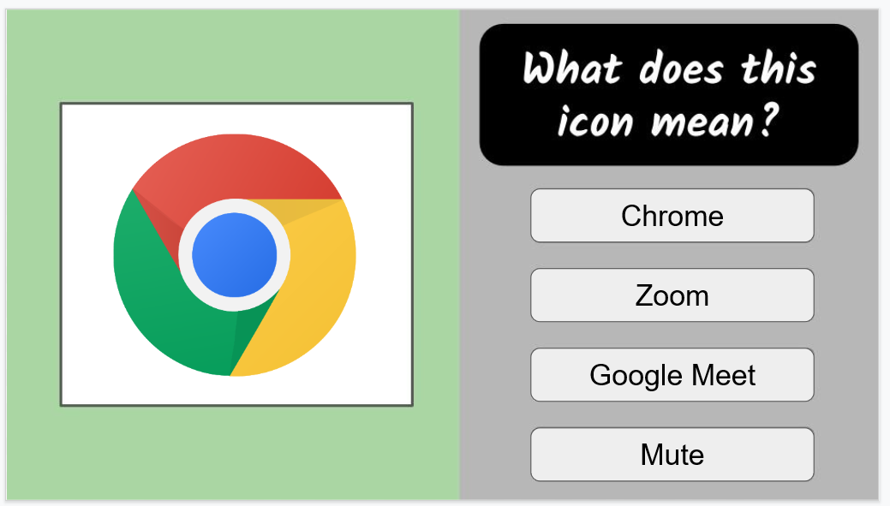

Slide 4
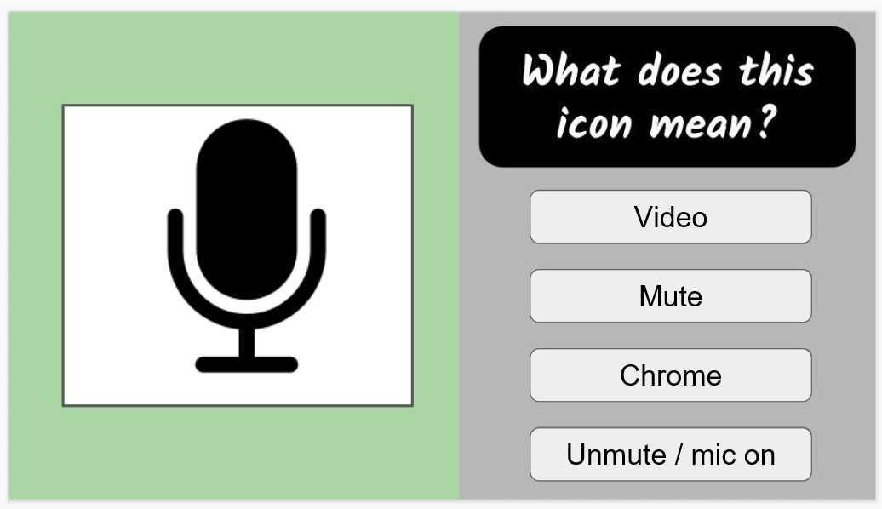

Slide 7
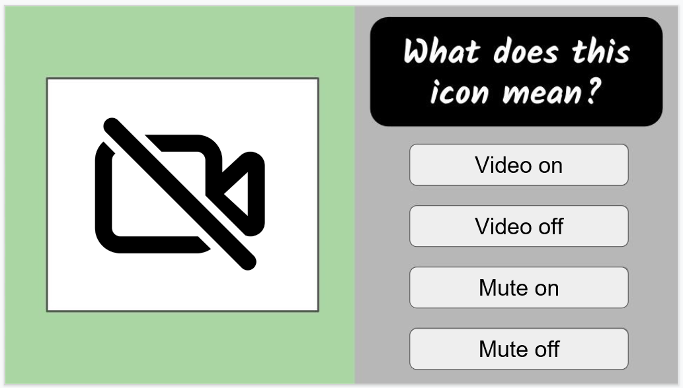

Slide 8
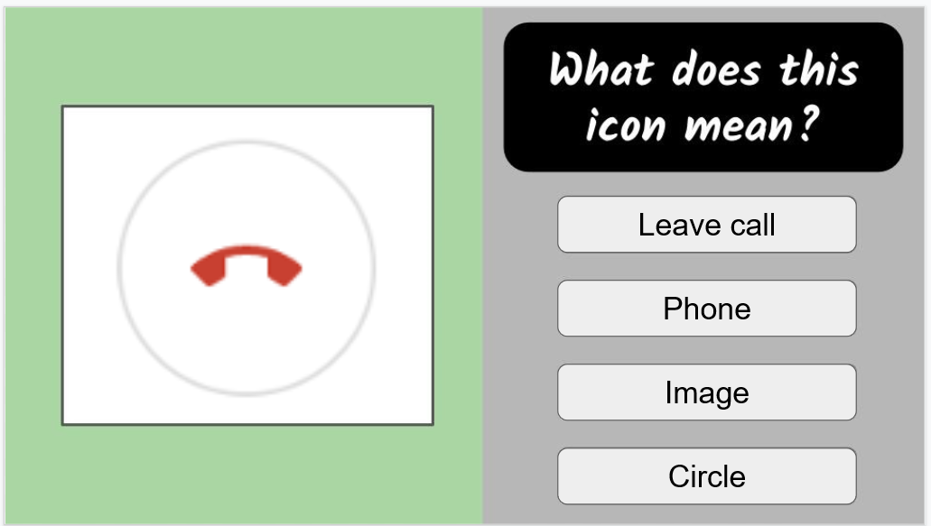

Slide 11
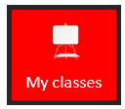
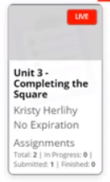
Some Icons You need to know:
Click on this to take you to our class Seesaw page! | Click on this to take you to our class Flipgrid | If you have a cobb device this icon takes you to all your classes.
Once in CTLS this Icon Takes you ack to all classes and small groups you are a part of. | When in a live session this view allows you to only see the teacher. | When a class is Live it will have this red live box on it.

Slide 12
Great Job

