Slide 1
RTI, Grading, and other important information for ESOL Students 2021-2022
Catherine and Amy
Acworth Elementary
October 2021

Slide 2
Cobb County ESOL Guidelines for Grading English Learners
We MUST consistently provide ESOL students with strategies, accommodations, and differentiation to curriculum-even when an ESOL teacher is not present (ALL SUBJECT AREAS)
NO FAILING GRADES IF:
Instruction has not been differentiated including assessments and or documentation of accommodations and differentiated instruction is not available.

Slide 3
Grading: What you Should do!
Classroom Teachers Should: Differentiate Based on Language levels (See Cheat Sheet)
Instruction
Assignments
Test
Classroom Teachers Should: Document and explain in written comments when needed that the grade is based on their performance and Language levels.
If a student completes the assignment or lesson and is meeting their can-do descriptors, they can and should receive same grade as students not receiving accommodations

Slide 4
Remember Accommodations and differentiation: Make the content obtainable NOT easier. Create equal access to the curriculum not an advantage.
Example: Write a Narrative Essay
Gen-Ed students: 3-5 paragraph essay
Level 1: Draw a picture of your narrative, teacher help student label picture, fill in a sentence stem of 3 sentences
Level 2: Draw a picture, graphic organizer with key vocabulary chart and sentence frames. Fill in to create solid paragraph.
Level 3: Graphic organizer, paragraph frame, transitional phrases. Should be able to create 2-3 paragraphs with these supports.
Level 4: Graphic organizer, paragraph frame, transitional phrases, Expectation moves from basic sentence to more complex. 2-3 paragraphs with these supports
Level 5: Graphic organizer, process checklist, 4-5 paragraphs with these supports..

Slide 5
We Are Here to Support You
If you ever have a question about grading, Please collaborate with the ESOL push-in teacher
If you serve your own kids-we are happy to help in anyway if you need guidance or advice.

Slide 6
Grading: What if the student is not doing the work?
They can receive a failing grade if:
Students refuses to participate, not completing assignment, not turning in work, or not showing any progress even based on can-do-descriptors.
Don’t wait until the end of the grading period to address this situation
If you are seeing these behaviors, please collaborate with us so we can help the student communicate
Is it a language problem?
Example from 3rd grade this year…

Slide 7
RTI and ESOL Students
Remember ESOL means the students is not proficient in English. Therefore, do not tier them because they are behind and struggling because they are NOT PROFICIENT IN ENGLISH.
If you refer a student, the ESOL teacher/ and classroom teacher will need to collaborate to create a language acquisition goal. (determine if language is or is not part of the challenge)
All ESOL students should receive differentiated Tier 1 Strategies
If they do not make adequate progress compared to other EL’s at same level, then they could be discussed for Tier 2.
Must consider
Time in country
Exposure to English
Access levels
Interruption of schooling
Truly had tier 1 correctly done

Slide 8
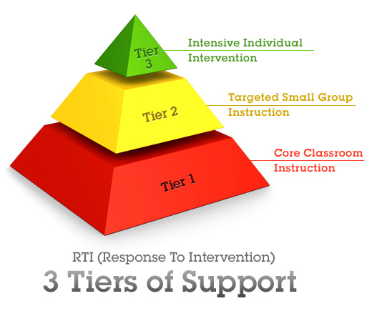
ESOL Students On Tier 2
Steps
Teacher has effectively done tier 1 instruction and has documentation of consistent differentiated instruction, lessons, assignments, and assessments.
Even with Tier 1 support student is not making progress comparable to other ESOL students at same level
Teacher keeps an ESOL Profile sheet
Together with ESOL teacher we discuss the “Right Question Sheet”
If committee determines yes the student should be placed on Tier 2 a language goal must be made in the lowest domain area
Data collected for 4-6 weeks by ESOL Teacher

Slide 9
How should Tier 1 be implemented
Tier 1: Is core classroom instruction and then tier 2 is for the 15-20% of students who are falling behind and need some additional support.
Now 20-30% of all our students are falling behind. We need to adjust our TIER 1 teaching to meet the need. You can not tier your whole class!
From the county: All students should receive scientific, research-based core instruction implemented with integrity and emphasizing grade-level standards and school wide behavioral expectations. Instruction at Tier 1 should be EXPLICIT, DIFFERENTIATED and include FLEXIBLE grouping and active students' engagement.
Remember supports are tiered students are not: students receive supports or accommodations based on need and development.
If our Tier 1 instruction is Solid and truly scaffolded the students will meet the high expectations established and the need to Tier students will diminish.
See Tier 1 example sheet ( a starting place)

Slide 10
Any Questions
We are here to support you always.
Who do we need to remove from Tier?
We will attend RTI meetings and will be meeting with you Next week to help get RTI corrected for ESOL students

