Slide 1
Authors Purpose
Easy As P. I. E

Slide 2
EQ: What is the authors purpose for writing a story?
There are 3 reasons why an author writes a story.
1. To persuade
2. To inform
3.To entertain
Think about it. It spells PIE.
P= persuade, I= inform, E= entertain

Slide 3
What does Authors Purpose Mean?
Authors purpose lets you know why the author sat down and wrote the book or text.
If the author writes to persuade the reader about something he or she wants to persuade them to do something.
When the author writes to inform the reader about something, they are writing to give the reader facts and information about a topic.
When the author writes to entertain he or she writes it to make the reader laugh or be entertained!

Slide 4
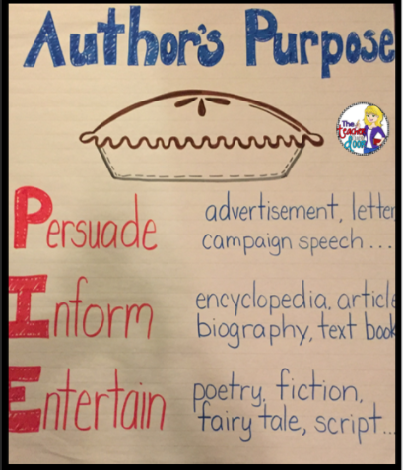
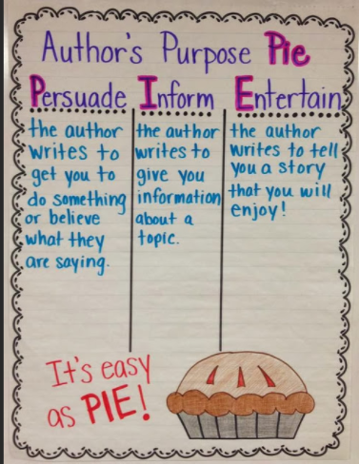
Now let's read some text and figure out the purpose
First Read the Text
Next Decide Why the Author wrote the story
Remember its easy as PIE!

Slide 5
Tigers
Tigers should be saved because they are endangered. They are being hunted for their fur. So that’s why I think we should help them. You can donate online for them or join a club. That’s why I think everybody should help save tigers.
by: Ella Templeton
Did the author write to Persuade, Entertain, or Inform?

Slide 6
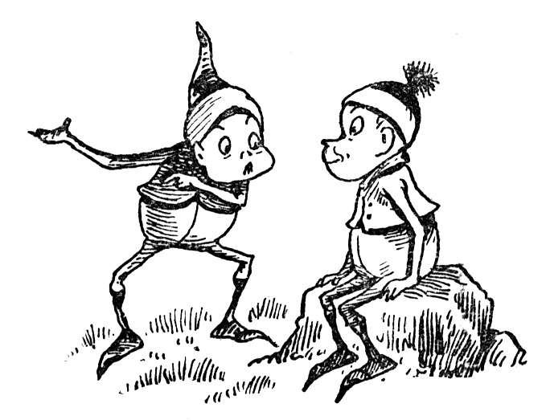
THAT’S RIGHT TO PERSUADE!
The author was trying to convince us or PERSUADE us to help him save tigers.

Slide 7
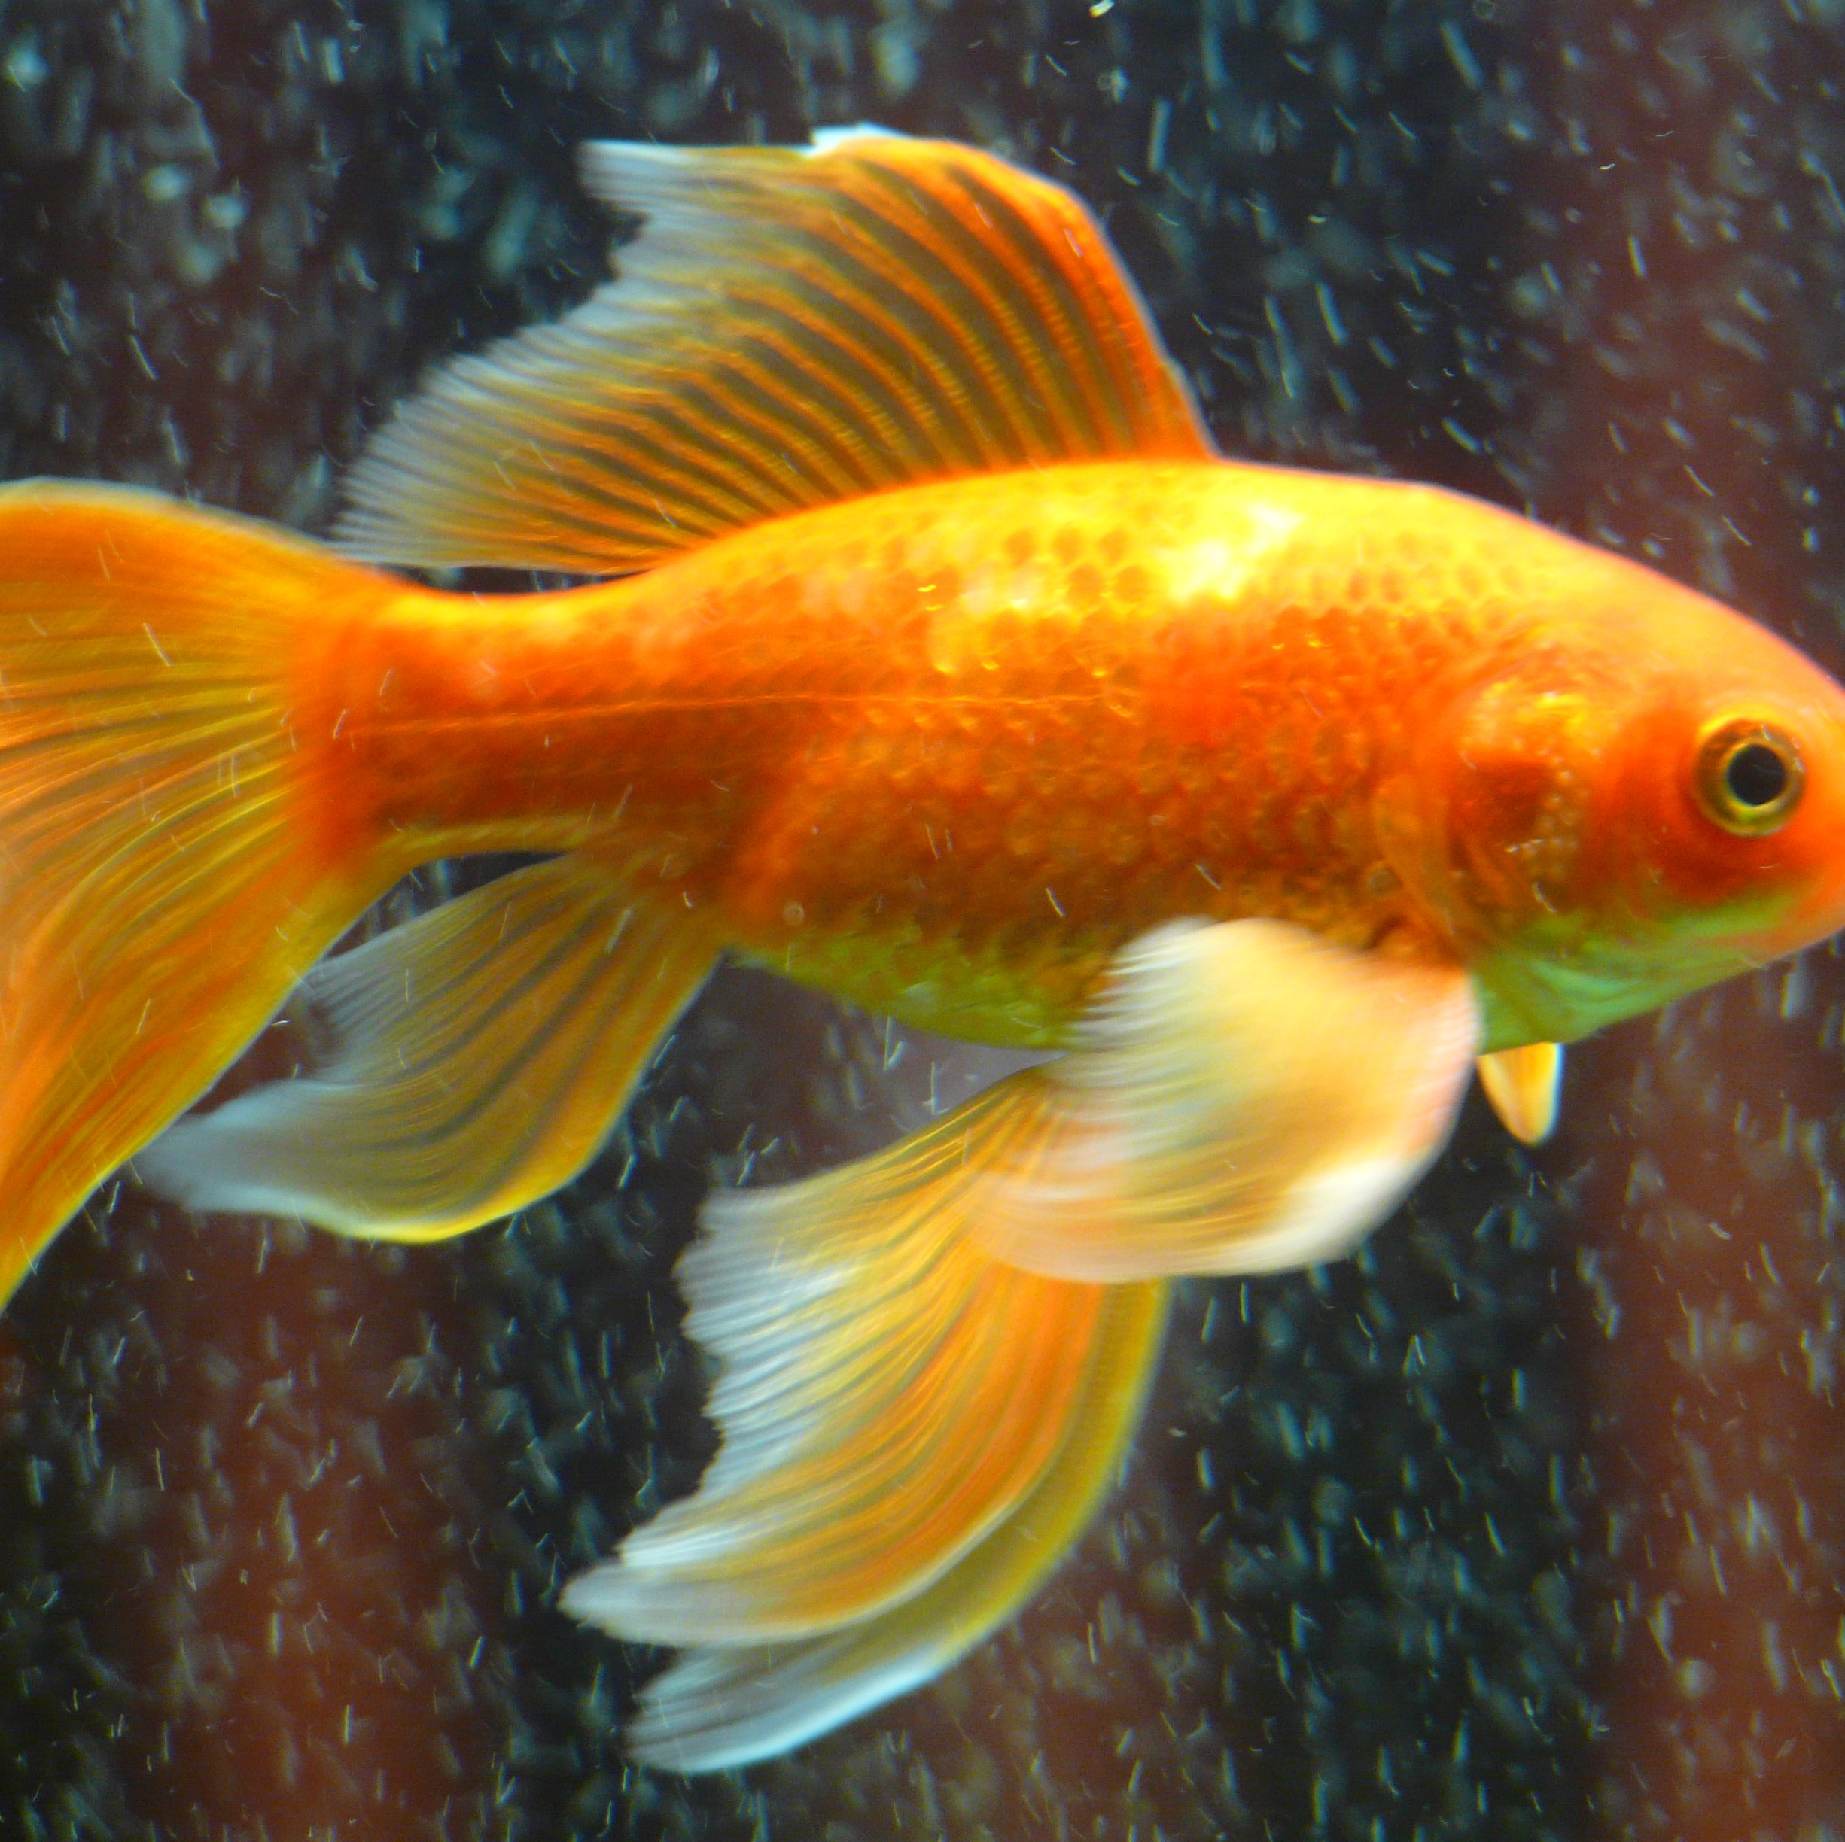
Fish
Fish are creatures that can only survive in the water. Fish lay eggs just like birds, reptiles, and amphibians. They have gills that help them breath underwater. Their gills are like lungs. Fish also have scales instead of skin. Fish eat worms or other small fish.
Did the author write to Persuade, Entertain, or Inform?

Slide 8
THAT’S RIGHT TO INFORM!
The author was trying to teach us or Inform us about fish.

Slide 9
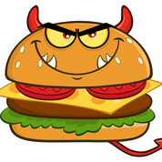
The Hamburgers Are Alive
One day I went outside to check on the cooking burgers and they came alive! I fought them with a knife and they fought back with the ketchup and mustard. I decided to grab some cheese and wrap them up. Finally, I shut the grill and I won! The hamburgers were charred. Just beware of these evil burgers!
Did the author write to Persuade, Entertain, or Inform?

Slide 10
THAT’S RIGHT TO ENTERTAIN!
The author was trying to make us laugh or ENTERTAIN us with his story about hamburgers.

Slide 11
Now you can try it on your own!

